Slide 1

CS 188: Artificial Intelligence
Introduction
Spring 2023
University of California, Berkeley
[These slides were created by Dan Klein and Pieter Abbeel for CS188 Intro to AI at UC Berkeley (ai.berkeley.edu).]
Notes:
Please retain proper attribution, including the reference to ai.berkeley.edu. Thanks!

Slide 2
First Half of Today: Intro and Logistics
Staff introductions: Professor Russell, Peyrin, and course staff
Course logistics
Lectures, discussions, office hours, and exams
Resources and communication platforms
Collaboration and academic honesty
DSP and extenuating circumstances
Stress management and mental health

Slide 3
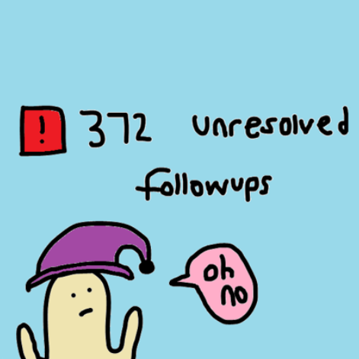
Staff Introductions: Peyrin (he/him)
Did my undergrad at Berkeley (2017-2021)
TA for 10 semesters (8x CS 161, 3x CS 61C, 1x CS 188)
Also been on staff for CS 61A, EE 16A, EE 16B
Did a 5th year MS at Berkeley (2021-2022)
Research focus: computer science education
Advisors: Nicholas Weaver and Dan Garcia
First-year lecturer in EECS
I’m paid exclusively to care about students and staff
First time teaching a non-summer class as instructor, so your feedback/advice/complaints are appreciated!
Please call me “Peyrin”!
No “professor”, “Mr.”, “sir”, “doctor”, etc. I’m not paid enough for that.
Actual real picture of me.

Slide 4
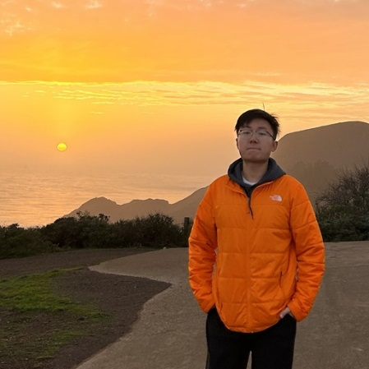
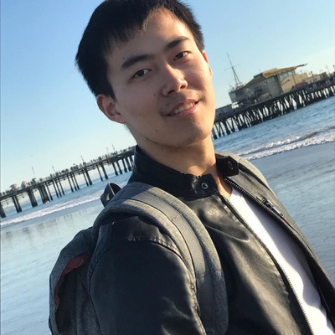
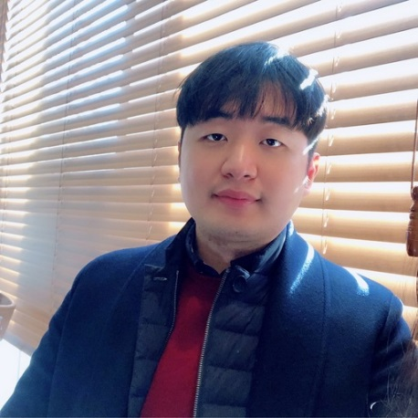
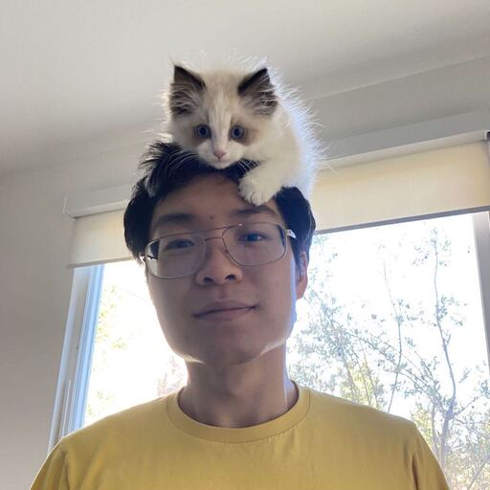
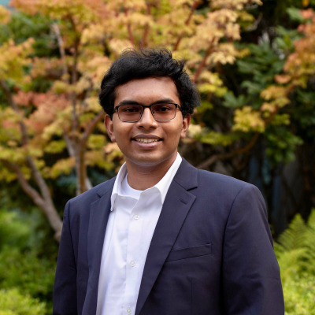
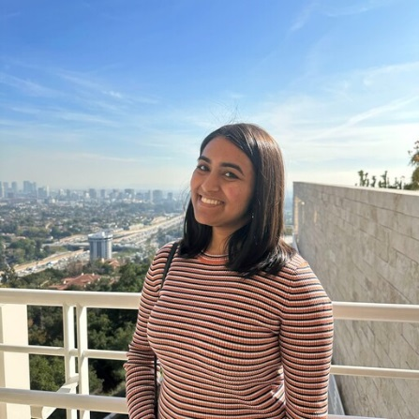
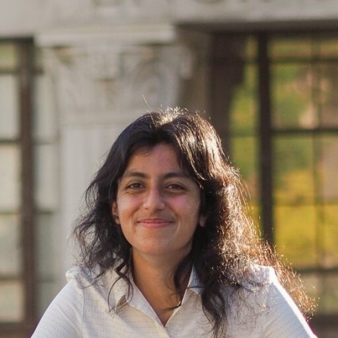
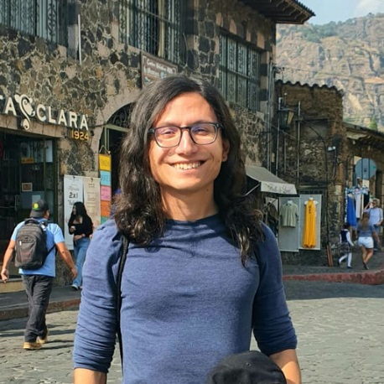
Our talented course staff!
Xiangwei Kong
he/him
Tianjun Zhang
Suhong Moon he/him
Simon Zhai
Sid Ijju he/him
Shivana Anand
she/her
Sashrika Pandey she/her
Rudy Corona
he/they

Slide 5
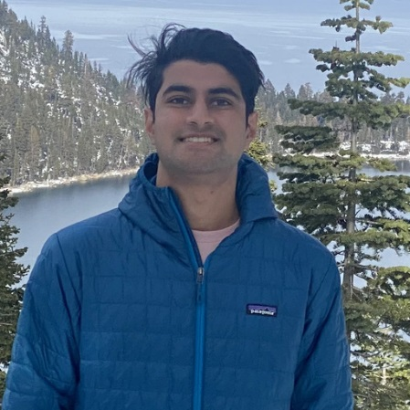
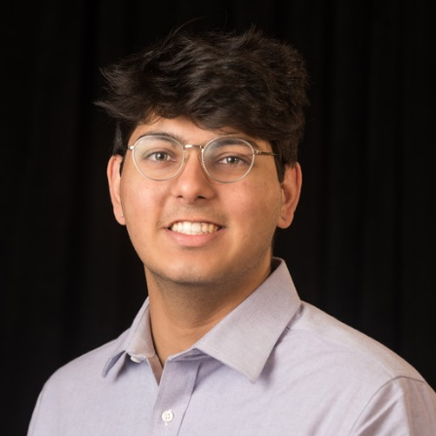

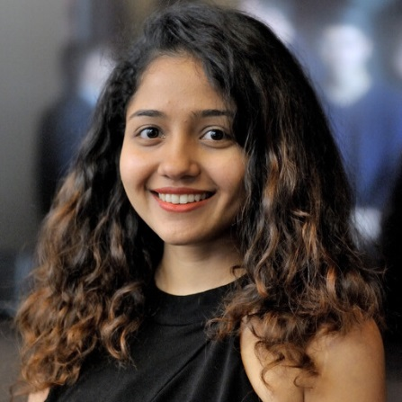
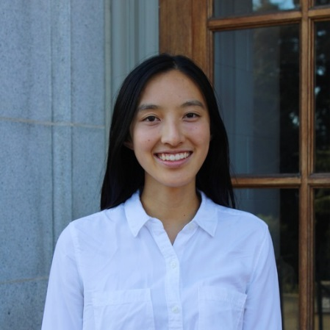
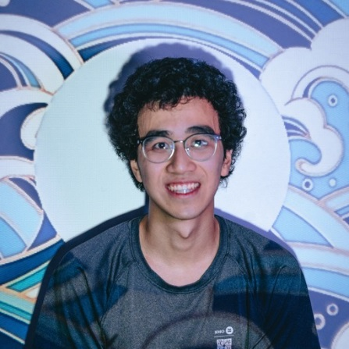
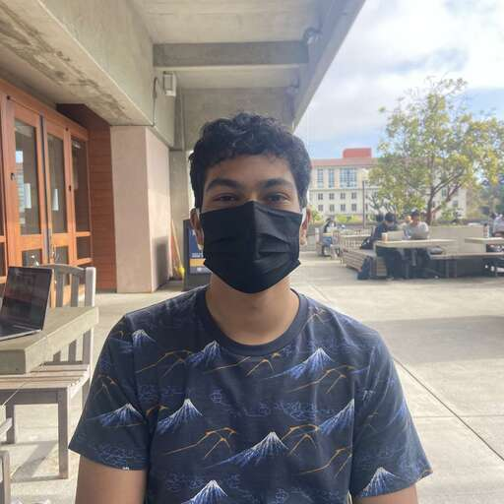
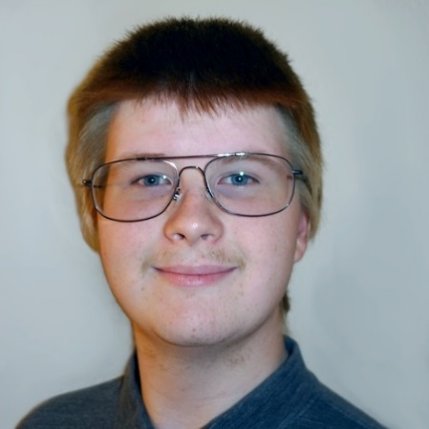
Our talented course staff!
Rishi Parikh he/him
Nitish Dashora
he/him
Niklas Lauffer he/him
Medhini Gulganjalli Narasimhan
Joy Liu
she/her
Jerry Sun
he/him
Hrish Leen
he/him
Evgeny Pobachienko he/him

Slide 6

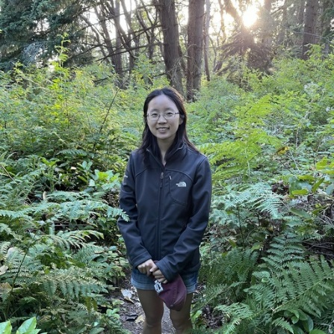
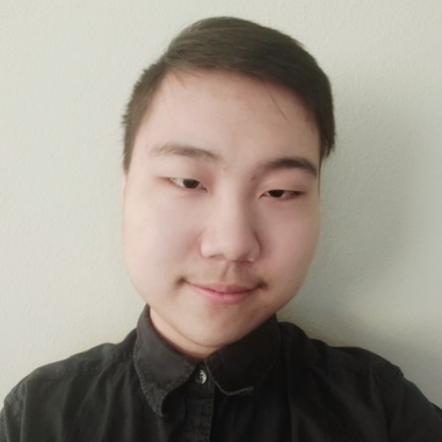
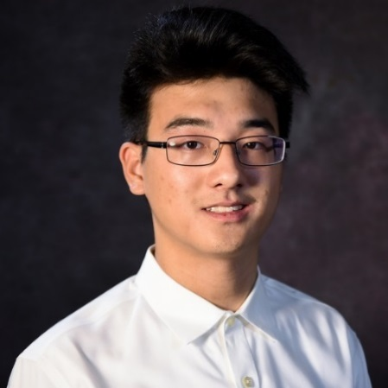

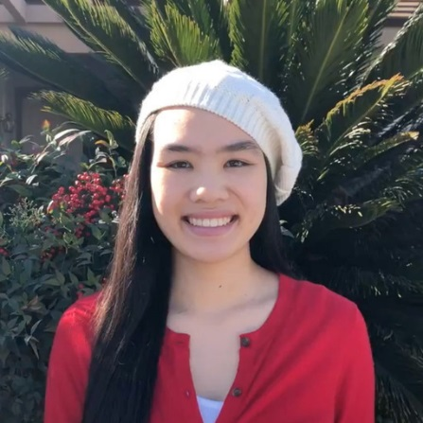
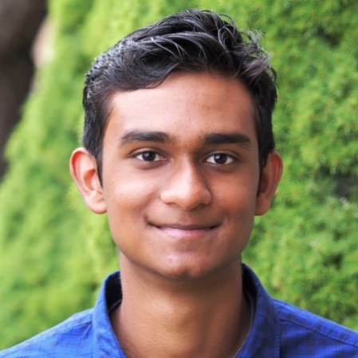

Our talented course staff!
Cham Yao
Catherine Chen
she/her
Anthony Han he/him
Andrew Wang
he/him
Andrew Qin
he/him
Alina Trinh
she/her
Ajay Sridhar he/him
might have a few more people join so here’s a placeholder

Slide 7
Enrollment
Course staff does not control enrollment; we have to follow department policy
Only CS majors will be able to enroll this spring
More details on the course website

Slide 8
Course Structure: Lectures
You are here!
Tuesday/Thursday, 5:00–6:30 PM PT
Attendance is not taken
But there may be a bit of extra credit for attending
You can attend:
In-person in Wheeler 150
Remotely over Zoom (we’ll try our best to livestream)
Asynchronously by watching recordings (posted on website)

Slide 9
Course Structure: Discussions
We offer three types of discussions
Regular discussions
Exam prep discussions
Extended-time discussions
We’ll try to make recordings, but no promises
Discussion schedule available on website
Discussions start next week (January 23)
You can attend any discussion section you want (no need to enroll in a section)
A bit of extra credit available for attendance

Slide 10
Course Structure: Office Hours
Join in-person or remotely to talk to staff about content, ask questions on assignments, or raise any concerns you have
Schedule and queue available on website
Office hours start next week (January 23)

Slide 11
Course Structure: Exams
Save the dates!
Midterm: Monday, March 6, 8–10pm PT
Final exam: Friday, May 12, 11:30am–2:30pm PT
If you can’t make it:
We’ll offer remote exams at the listed time
We’ll offer an in-person-only alternate exam right after the listed time
More logistics closer to the exam

Slide 12
Resources
Course website: https://inst.eecs.berkeley.edu/~cs188/sp23/
All resources (slides, notes, recordings, assignments, etc.) posted here
Ed: Discussion forum replacing Piazza
Staff email for private concerns: cs188@berkeley.edu
Making a private post on Ed is easier/faster
Gradescope: Submit assignments here

Slide 13
Grading Structure
Projects (25%)
Python programming assignments, autograded
You can optionally work with a partner
Reduced credit for submitting late, unless you have an extension
Homework (20%)
Electronic homework: Autograded on Gradescope
Written homework: One question per week, graded by TAs on correctness
Submit individually (but feel free to discuss with others)
No late submissions, unless you have an extension
Midterm (20%), Final Exam (35%)

Slide 14
Extensions and Accommodations
We’ll drop your lowest homework score
You have 5 slip days to use across the projects
See course policies page for details on how they work
If you ever need an extension, please request one!
We’re here to support you, and we understand that life happens.
Extension form will be posted on the website

Slide 15
DSP
Disabled Students’ Program (DSP)
There’s a variety of accommodations UC Berkeley can help us set up for you in this class
https://dsp.berkeley.edu/
Are you facing barriers in school due to a disability?
Apply to DSP!
We maintain proper access controls on this information: Only instructors, course managers, head TAs, and logistics TAs can access any DSP-related info
Our goal is to teach you the material in our course. The more accessible we can make it, the better.

Slide 16
Collaboration and Academic Dishonesty
We’re here to help! There are plenty of staff and resources available for you
You can always talk to a staff member if you’re feeling stressed or tempted to cheat
Collaboration on homework is okay, but please cite collaborators
Do not post solutions online or share with others!
Academic dishonesty policies
Reported to Center of Student Conduct
Negative points on assignments, and/or F in the class

Slide 17
Stress Management and Mental Health
Your health is more important than this course
If you feel overwhelmed, there are options
Academically: Ask on Ed, talk to staff in office hours, set up a meeting with staff to make a plan for your success this semester
Non-academic:
Counselling and Psychological Services (CAPS) has multiple free, confidential services
Casual consultations: https://uhs.berkeley.edu/counseling/lets-talk
Crisis management: https://uhs.berkeley.edu/counseling/urgent
Check out UHS’s resources: https://uhs.berkeley.edu/health-topics/mental-health

Slide 18
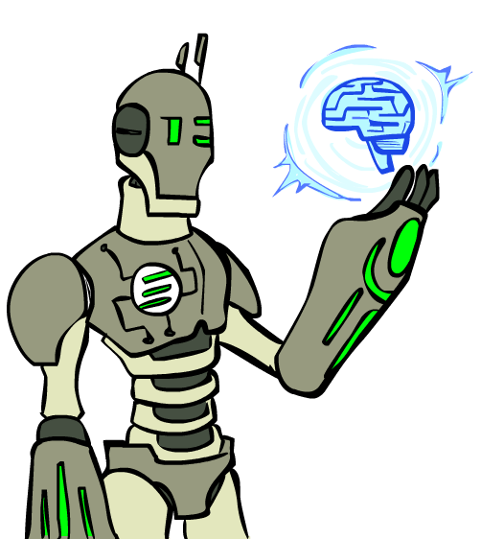
Second Half of Today: What is AI?
What is artificial intelligence?
What can AI do?
What should we worry about?
What can we do about those things?
What should we not worry about?
What is this course?

Slide 19
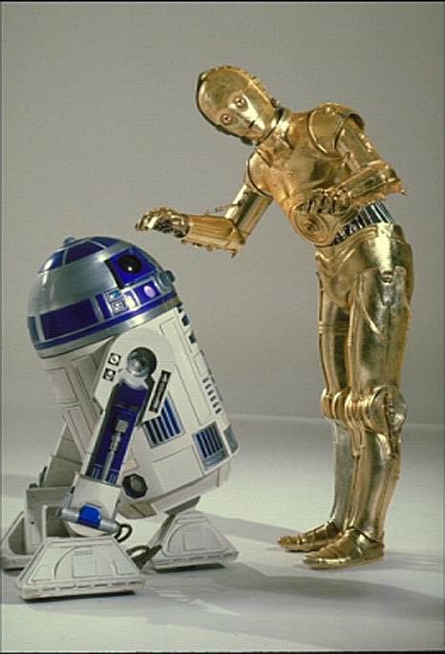
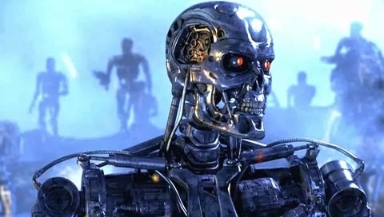
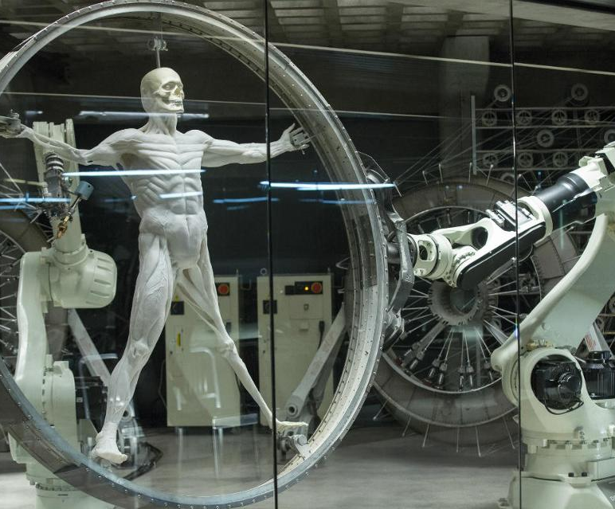


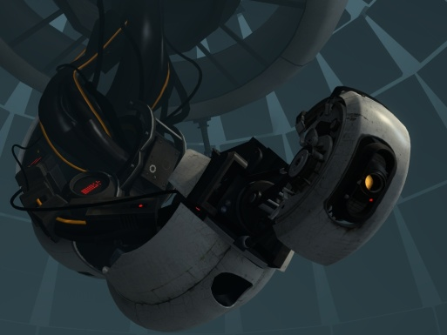

Sci-Fi AI?

Slide 20
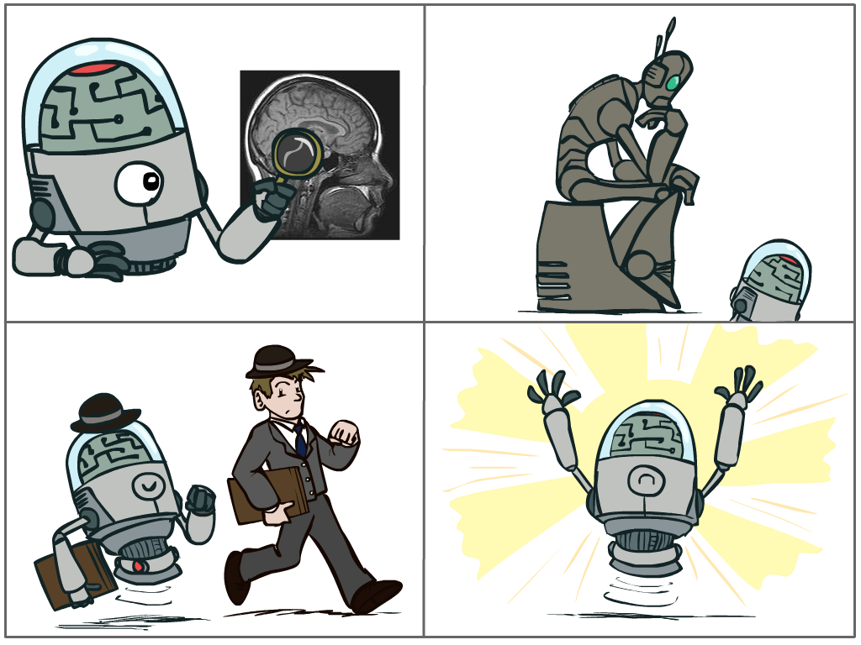
What is AI?
The science of making machines that:
Think like people
Think rationally
Act like people
Act rationally
Notes:
Top left: natural intelligence -- Think like people --- cognitive science, neuroscience
Bottom left: who cares about how they think? act like people --- actually very early definition, dating back to Alan Turing --- Turing test; problem to do really well you start focusing on things like don’t answer too quickly what the square root of 1412 is, don’t spell too well, and make sure you have a favorite movie etc. So it wasn’t really leading us to build intelligence
Think rationally – correct thought process -- long tradition dating back to Aristotle --- this is how to think so that you don’t make mistakes; but not a winner, because difficult to encode how to think / especially in the face of unknowns/uncertainty, and in the end it’s not about how you think, it’s about how you end up acting

Slide 21
Rational Decisions
We’ll use the term rational in a very specific, technical way:
Rational: maximally achieving pre-defined goals
Rationality only concerns what decisions are made (not the thought process behind them)
Goals are expressed in terms of the utility of outcomes
Being rational means maximizing your expected utility
A better title for this course would be:
Computational Rationality

Slide 22
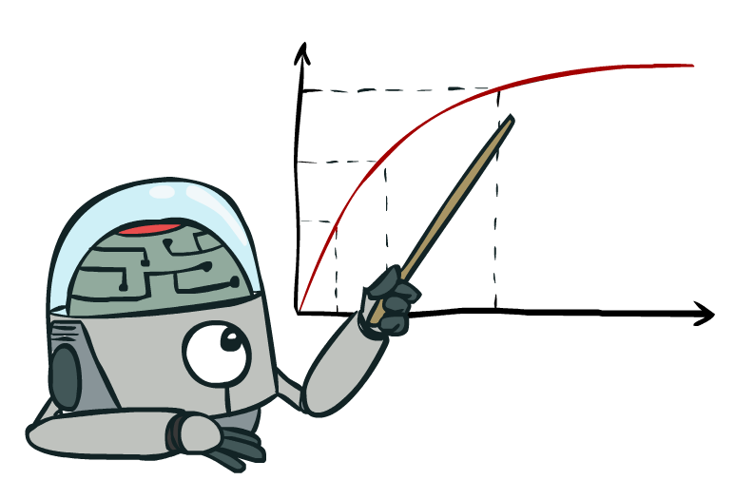
Maximize Your Expected Utility

Slide 23
What About the Brain?
Brains (human minds) are very good at making rational decisions, but not perfect
Brains aren’t as modular as software, so hard to reverse engineer!
“Brains are to intelligence as wings are to flight”
Lessons learned from the brain: memory and simulation are key to decision making

Slide 24
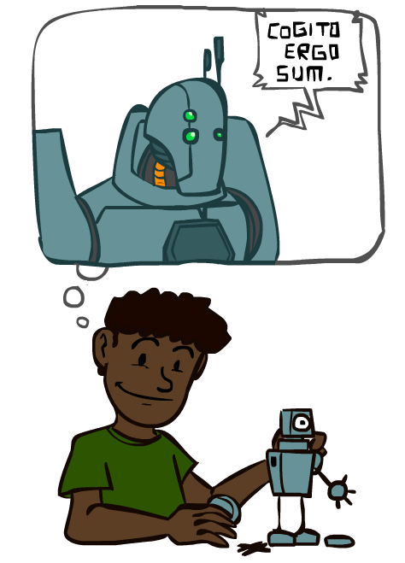
A (Short) History of AI

Slide 25


Slide 26
A (Short) History of AI
1940-1950: Early days
1943: McCulloch & Pitts: Boolean circuit model of brain
1950: Turing's “Computing Machinery and Intelligence”
1950—70: Excitement: Look, Ma, no hands!
1950s: Early AI programs, including Samuel's checkers program, Newell & Simon's Logic Theorist, Gelernter's Geometry Engine
1956: Dartmouth meeting: “Artificial Intelligence” adopted
1965: Robinson's complete algorithm for logical reasoning

Slide 27
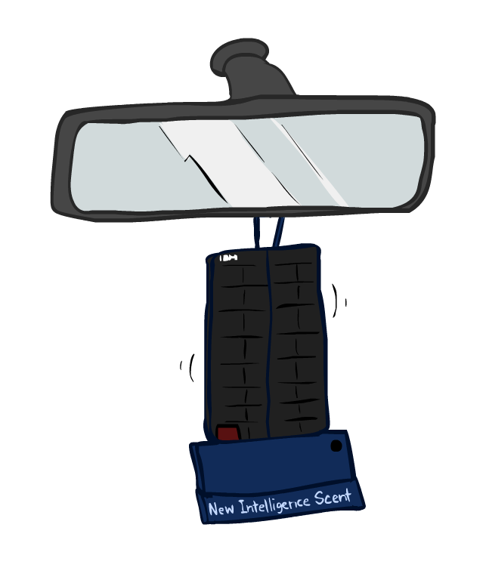
A (Short) History of AI
1970—90: Knowledge-based approaches
1969—79: Early development of knowledge-based systems
1980—88: Expert systems industry booms
1988—93: Expert systems industry busts: “AI Winter”
1990—: Statistical approaches
Resurgence of probability, focus on uncertainty
General increase in technical depth
Agents and learning systems… “AI Spring”?
1996: Kasparov defeats Deep Blue at chess
1997: Deep Blue defeats Kasparov at chess
“I could feel --- I could smell --- a new kind of intelligence across the table.” ~Kasparov

Slide 28
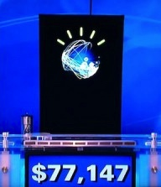
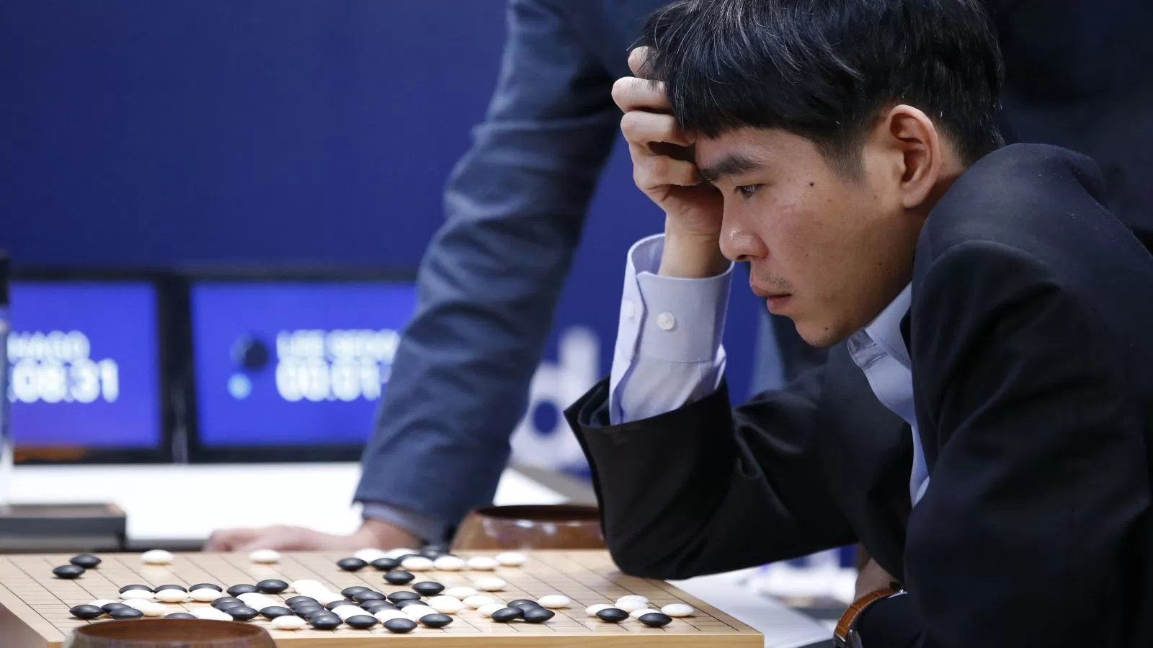
A (Short) History of AI
2000—: Where are we now?
Big data, big compute, neural networks
Some re-unification of sub-fields
AI used in many industries
Chess engines running on ordinary laptops can defeat the world’s best chess players
2011: IBM’s Watson defeats Ken Jennings and Brad Rutter at Jeopardy!
2016: Google’s AlphaGo beats Lee Sedol at Go

Slide 29
What Can AI Do?
Quiz: Which of the following can be done at present?
Play a decent game of Jeopardy?
Win against any human at chess?
Win against the best humans at Go?
Play a decent game of tennis?
Grab a particular cup and put it on a shelf?
Unload any dishwasher in any home?
Drive safely along the highway?
Drive safely along Telegraph Avenue?
Buy a week's worth of groceries on the web?
Buy a week's worth of groceries at Berkeley Bowl?
Discover and prove a new mathematical theorem?
Perform a surgical operation?
Unload a know dishwasher in collaboration with a person?
Translate spoken Chinese into spoken English in real time?
Write an intentionally funny story?

Slide 30
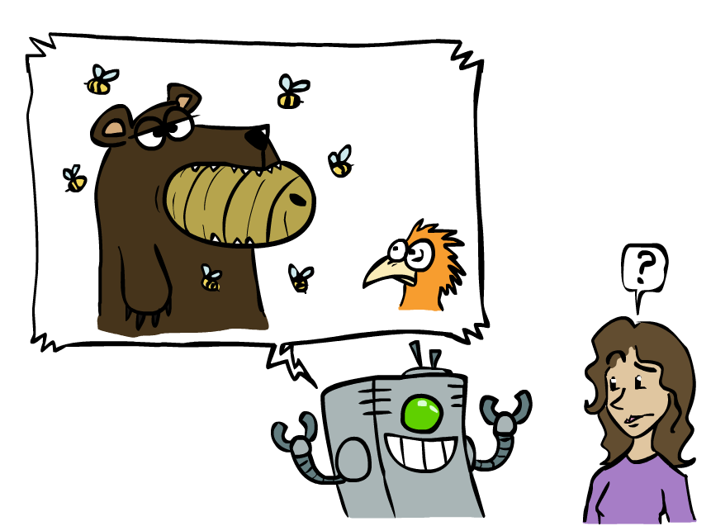
Unintentionally Funny Stories
One day Joe Bear was hungry. He asked his friend Irving Bird where some honey was. Irving told him there was a beehive in the oak tree. Joe walked to the oak tree. He ate the beehive. The End.
Henry Squirrel was thirsty. He walked over to the river bank where his good friend Bill Bird was sitting. Henry slipped and fell in the river. Gravity drowned. The End.
Once upon a time there was a dishonest fox and a vain crow. One day the crow was sitting in his tree, holding a piece of cheese in his mouth. He noticed that he was holding the piece of cheese. He became hungry, and swallowed the cheese. The fox walked over to the crow. The End.
[Shank, Tale-Spin System, 1984]

Slide 31
AI in the News
Perhaps you’ve heard that there is an exciting new Barack Obama book that everyone’s talking about! I’m not talking about A Promised Land, the 751-page memoir which Obama spent four years writing.
No, I’m talking about Barack Obama Book, a 61-page tome by an author named “University Press.” Why is Barack Obama Book selling so well? Thanks to sponsored listings and canny search engine optimization, the book appears above Barack Obama’s actual memoir if you search Amazon for—you guessed it—“barack obama book.”
What is Barack Obama Book? It’s not a book, exactly. It’s an SEO ploy by a shadowy company that has scores of $2.99 knockoffs ready to be downloaded, from quickie biographies of au courant figures like Obama, Harris, and Dolly Parton, to obvious bestseller ripoffs like Caste: A Brief History and Ready Player 3, 2, 1: A Brief History (?).
I don’t think Barack Obama Book was written by a human being, but I do think the A.I. that excreted it made some decent points about Barack Obama.
https://slate.com/culture/2020/11/what-is-barack-obama-book-university-press-amazon.html

Slide 32
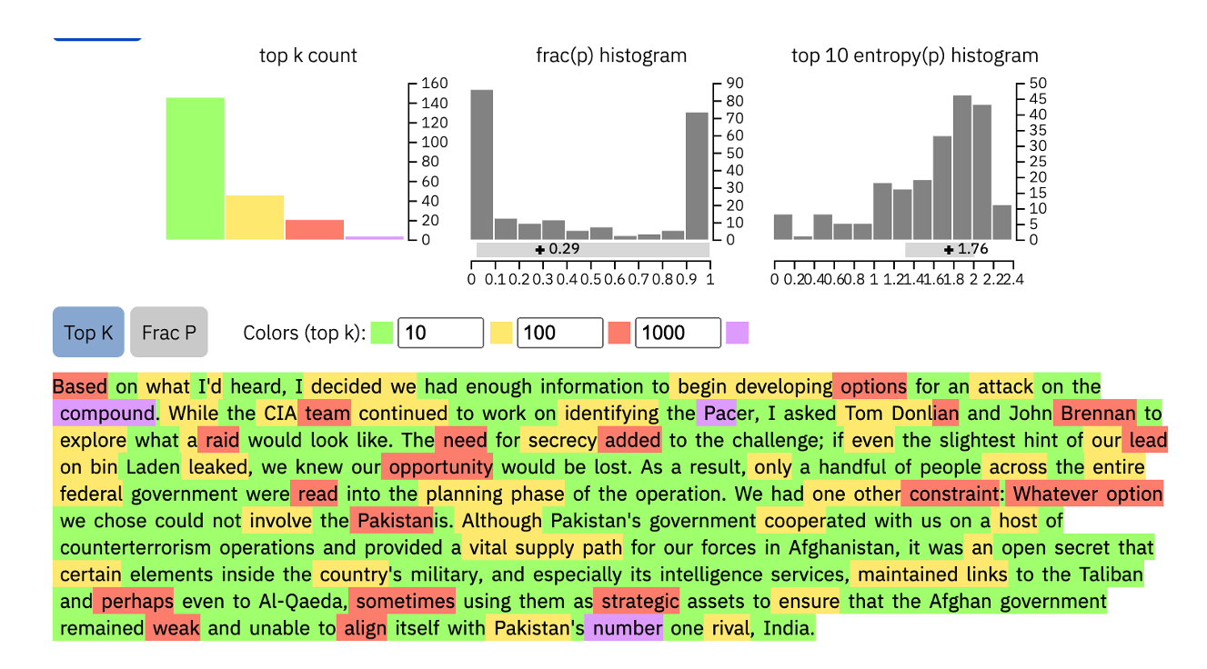

AI in the News
https://slate.com/culture/2020/11/what-is-barack-obama-book-university-press-amazon.html

Slide 33
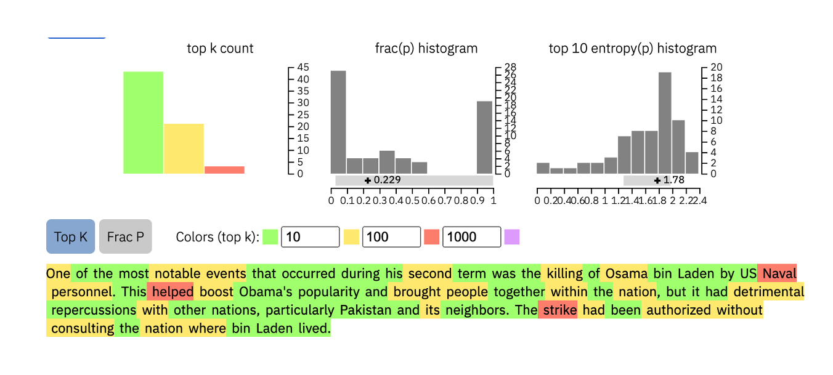

AI in the News
https://slate.com/culture/2020/11/what-is-barack-obama-book-university-press-amazon.html

Slide 34
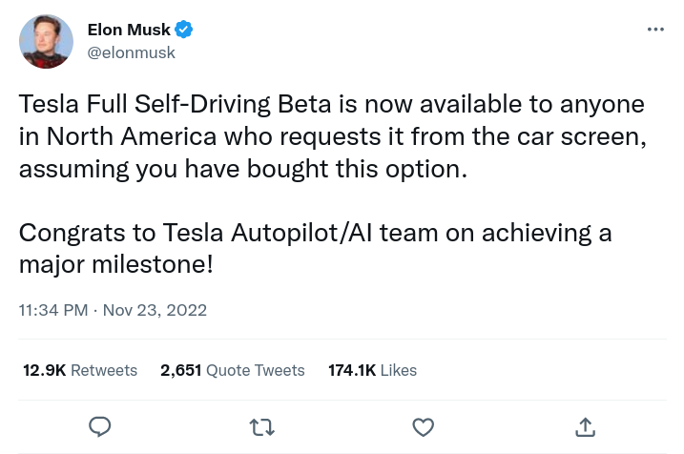
AI in the News

Slide 35
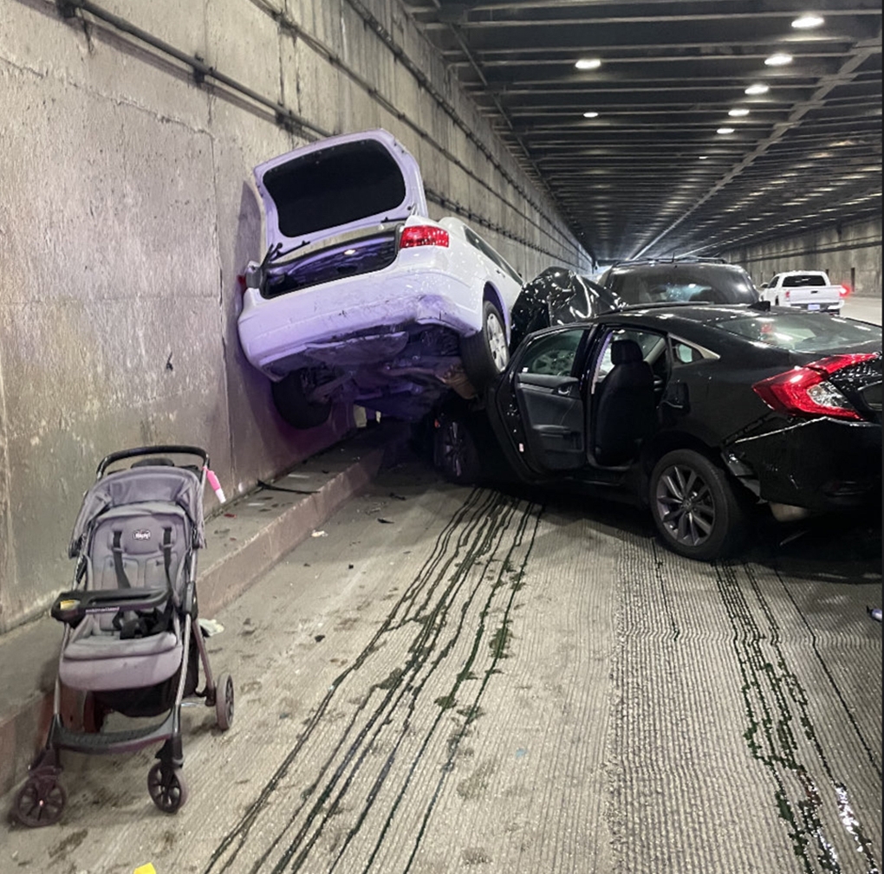
AI in the News
Highway surveillance footage from November 24 shows a Tesla Model S vehicle changing lanes and then abruptly braking in the far-left lane of the San Francisco Bay Bridge, resulting in an eight-vehicle crash.
As traditional car manufacturers enter the electric vehicle market, Tesla is increasingly under pressure to differentiate itself. Last year, Musk said that “Full Self-Driving” was an “essential” feature for Tesla to develop, going as far as saying, “It’s really the difference between Tesla being worth a lot of money or worth basically zero.”
https://theintercept.com/2023/01/10/tesla-crash-footage-autopilot/

Slide 36
Course Topics
Part 1: Intelligence from Computation
Fast search/planning
Constraint satisfaction (e.g. scheduling)
Adversarial and uncertain search (e.g. routing, navigation)
Part 2: Intelligence from Data
Probabilistic inference with Bayes’ nets (e.g. robot localization)
Decision theory
Supervised machine learning (e.g. spam detection)
Throughout: Applications
Natural language, vision, robotics, games, etc.

Slide 37
Should I take CS 188?
Yes, if you want to know how to design rational agents!
CS 188 gives you extra mathematical maturity
CS 188 gives you a survey of other non-CS fields that interact with AI (e.g. robotics, cognitive science, economics)
Disclaimer: If you’re interested in making yourself more competitive for AI jobs, CS 189 and CS 182 are better fits.
The last few CS 188 lectures (neural networks) are used by many modern state-of-the-art systems. CS 189 and CS 182 cover these in more depth

Slide 38
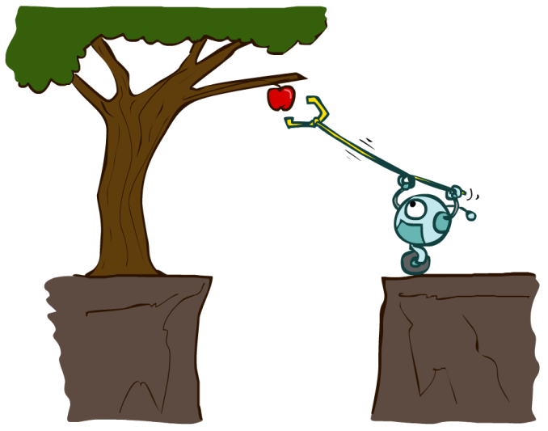
Designing Rational Agents
An agent is an entity that perceives and acts.
A rational agent selects actions that maximize its (expected) utility.
Characteristics of the percepts, environment, and action space dictate techniques for selecting rational actions
This course is about:
General AI techniques for a variety of problem types
Learning to recognize when and how a new problem can be solved with an existing technique
Sensors
Agent
Percepts
Environment
?
Actuators
Actions

Slide 39
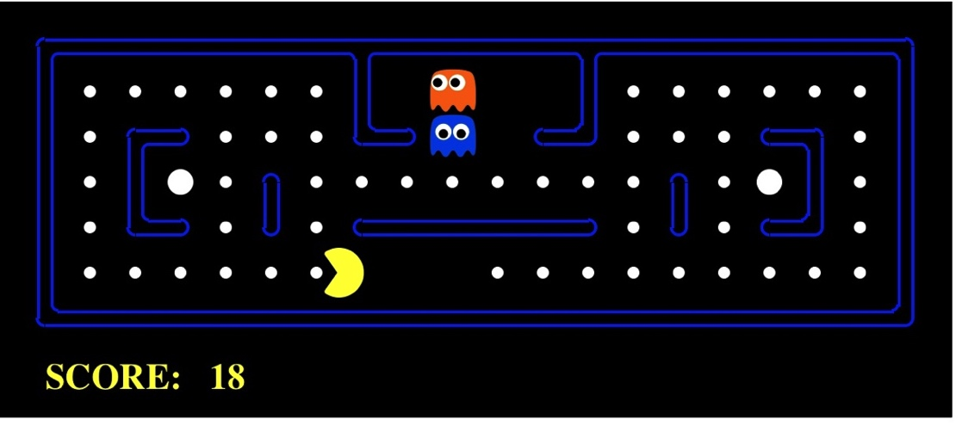
Pac-Man as an Agent
Agent
Environment
Sensors
Percepts
?
Actuators
Actions
Pac-Man is a registered trademark of Namco-Bandai Games, used here for educational purposes

Slide 40


